Slide 1


Data Structure
Course Code : ENCS205
Dr Swati Gupta
Associate Professor, School of Engineering & Technology
K.R. Mangalam University
Unit 4 :Trees and Graphs
Notes:
New Courses replaced with New Programmes

Slide 2

Minimum Spanning Tree :PRIMS
Session 57
Prims Algorithm
Prims Algorithm Example and Pseudo code
Brainstorming Session
Notes:
New Courses replaced with New Programmes

Slide 3
RECAP
Spanning Tree it is a subset of the edges of the graph that forms a tree (acyclic) where every node of the graph is a part of the tree.
Kruskal’s Algorithm builds the spanning tree by adding edges one by one into a growing spanning tree.
Notes:
New Courses replaced with New Programmes

Slide 4
PRIMS Algorithm
Prim's Algorithm is a greedy algorithm that is used to find the minimum spanning tree from a graph.
It finds the subset of edges that includes every vertex of the graph such that the sum of the weights of the edges can be minimized.
It starts with the single node and explores all the adjacent nodes with all the connecting edges at every step.
The edges with the minimal weights causing no cycles in the graph got selected.
Notes:
New Courses replaced with New Programmes

Slide 5
Algorithm for Prims Problem
Step 1: Determine an arbitrary vertex as the starting vertex of the MST. Step 2: Follow steps 3 to 5 till there are vertices that are not included in the MST (known as fringe vertex). Step 3: Find edges connecting any tree vertex with the fringe vertices.
Notes:
New Courses replaced with New Programmes

Slide 6
Algorithm for Prims Problem
Step 4: Find the minimum among these edges. Step 5: Add the chosen edge to the MST if it does not form any cycle. Step 6: Return the MST and exit
Notes:
New Courses replaced with New Programmes

Slide 7
PRIMS Algorithm
Spanning Tree it is a subset of the edges of the graph that forms a tree (acyclic) where every node of the graph is a part of the tree.
Kruskal’s Algorithm builds the spanning tree by adding edges one by one into a growing spanning tree.
It follows Greedy Approach which find solutions based on a sequence of choices which are “locally” optimal at each step.
Notes:
New Courses replaced with New Programmes

Slide 8
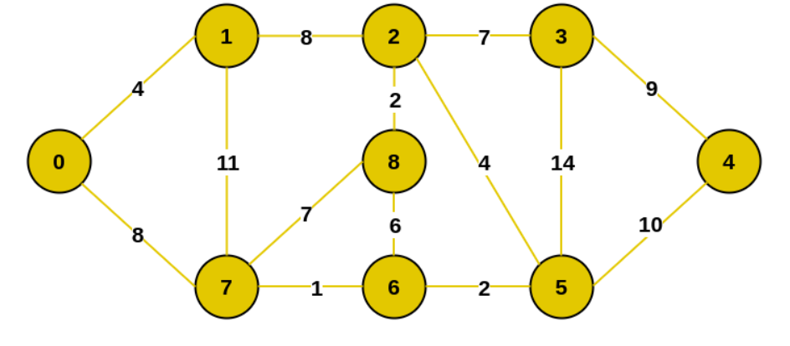
Practice Problem
Consider the following graph find the Minimum Spanning Tree (MST) using Prims Algorithm
Notes:
New Courses replaced with New Programmes

Slide 9
Practice Problem
Consider the following graph find the Minimum Spanning Tree (MST) using Prims Algorithm
Notes:
New Courses replaced with New Programmes

Slide 10
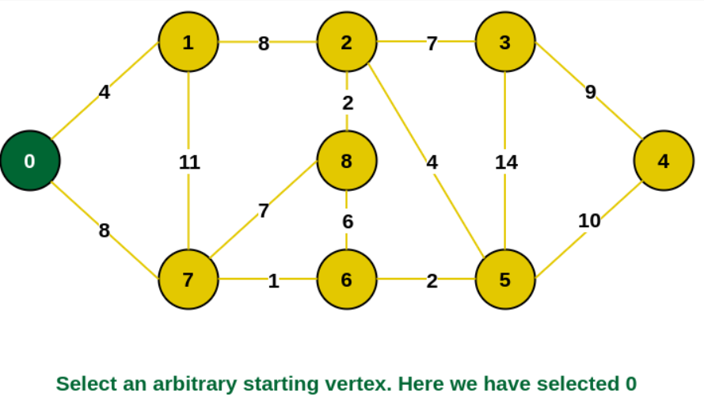
Practice Problem
Step 1: Firstly, we select an arbitrary vertex that acts as the starting vertex of the Minimum Spanning Tree. Here we have selected vertex 0 as the starting vertex.
Notes:
New Courses replaced with New Programmes

Slide 11
Practice Problem
Step 1: Firstly, we select an arbitrary vertex that acts as the starting vertex of the Minimum Spanning Tree. Here we have selected vertex 0 as the starting vertex.
Notes:
New Courses replaced with New Programmes

Slide 12
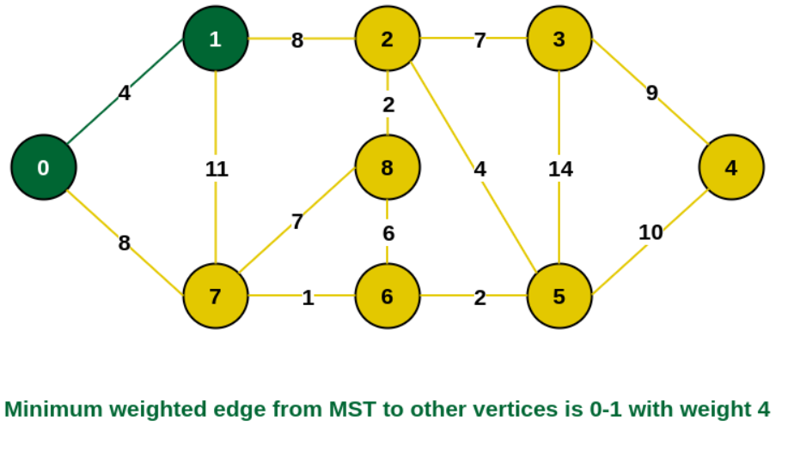
Practice Problem
Step 2: All the edges connecting the incomplete MST and other vertices are the edges {0, 1} and {0, 7}. Between these two the edge with minimum weight is {0, 1}. So include the edge and vertex 1 in the MST.
Notes:
New Courses replaced with New Programmes

Slide 13
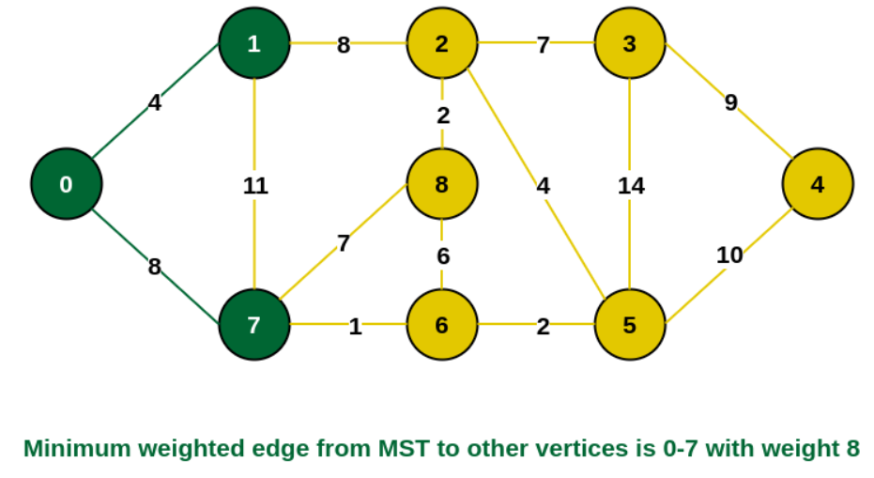
Practice Problem
Step 3: The edges connecting the incomplete MST to other vertices are {0, 7}, {1, 7} and {1, 2}. Among these edges the minimum weight is 8 which is of the edges {0, 7} and {1, 2}.
Notes:
New Courses replaced with New Programmes

Slide 14
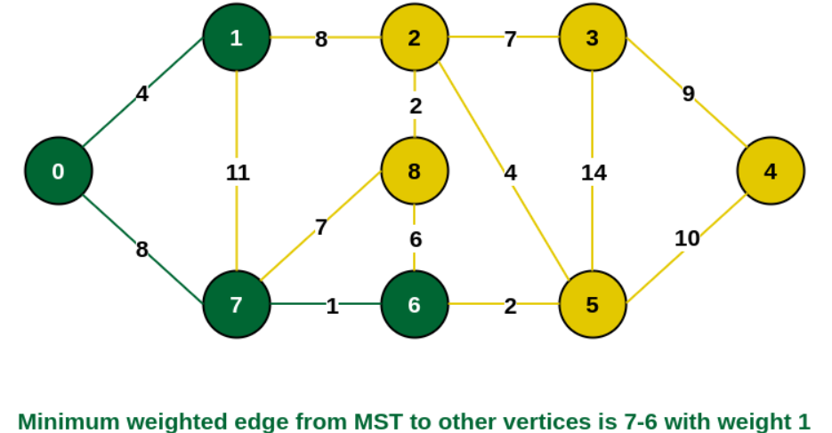
Practice Problem
Step 4: The edges that connect the incomplete MST with the fringe vertices are {1, 2}, {7, 6} and {7, 8}. Add the edge {7, 6} and the vertex 6 in the MST as it has the least weight (i.e., 1).
Notes:
New Courses replaced with New Programmes

Slide 15
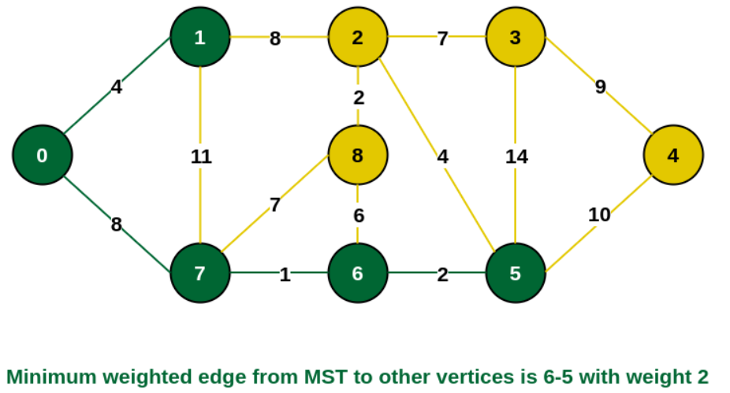
Practice Problem
Step 5: The connecting edges now are {7, 8}, {1, 2}, {6, 8} and {6, 5}. Include edge {6, 5} and vertex 5 in the MST as the edge has the minimum weight (i.e., 2) among them.
Notes:
New Courses replaced with New Programmes

Slide 16
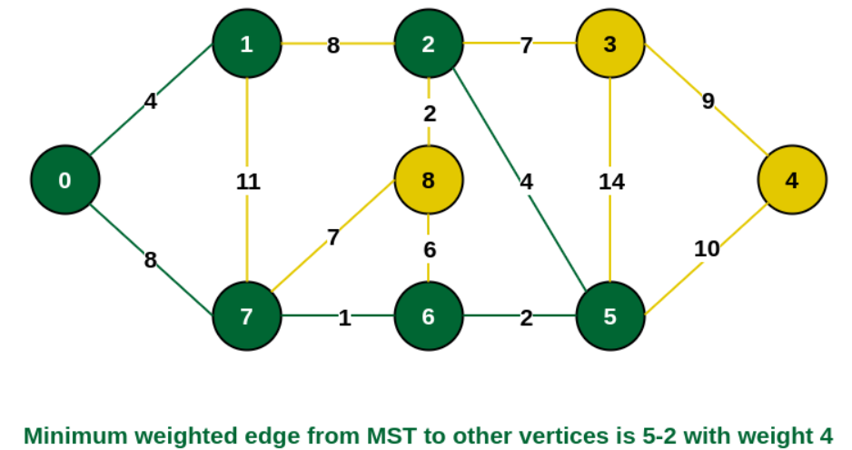
Practice Problem
Step 6: Among the current connecting edges, the edge {5, 2} has the minimum weight. So include that edge and the vertex 2 in the MST.
Notes:
New Courses replaced with New Programmes

Slide 17
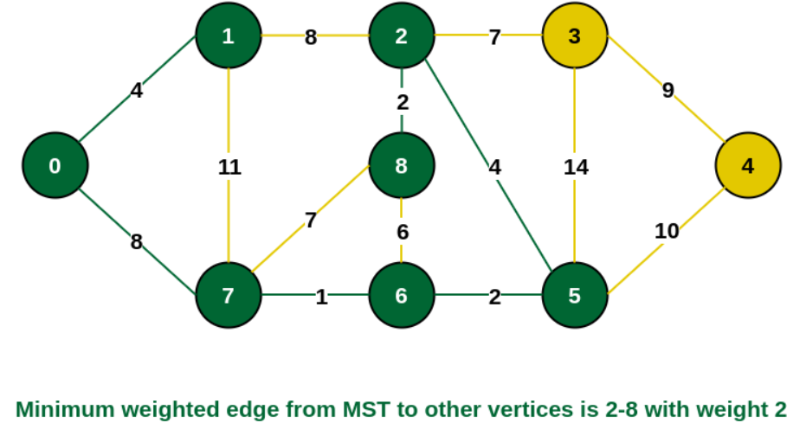
Practice Problem
Step 7: The connecting edges between the incomplete MST and the other edges are {2, 8}, {2, 3}, {5, 3} and {5, 4}. The edge with minimum weight is edge {2, 8} which has weight 2.
Notes:
New Courses replaced with New Programmes

Slide 18
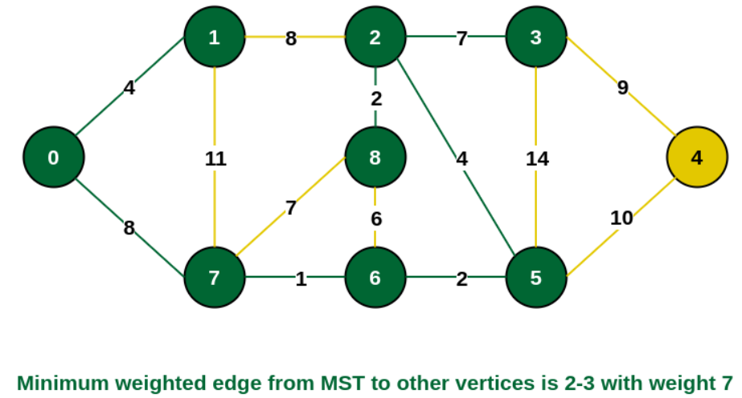
Practice Problem
Step 8: See here that the edges {7, 8} and {2, 3} both have same weight which are minimum. But 7 is already part of MST. So we will consider the edge {2, 3} and include that edge and vertex 3 in the MST.
Notes:
New Courses replaced with New Programmes

Slide 19
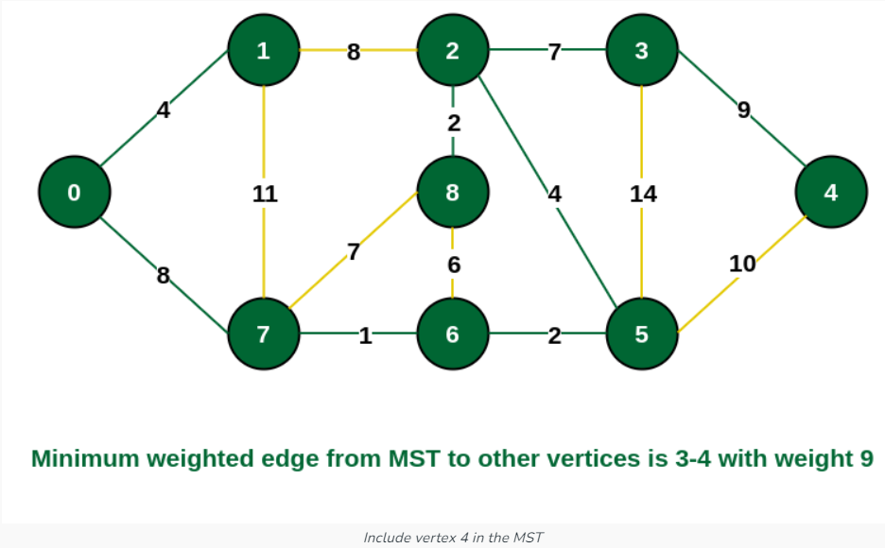
Practice Problem
Step 9: Only the vertex 4 remains to be included. The minimum weighted edge from the incomplete MST to 4 is {3, 4}.
Notes:
New Courses replaced with New Programmes

Slide 20
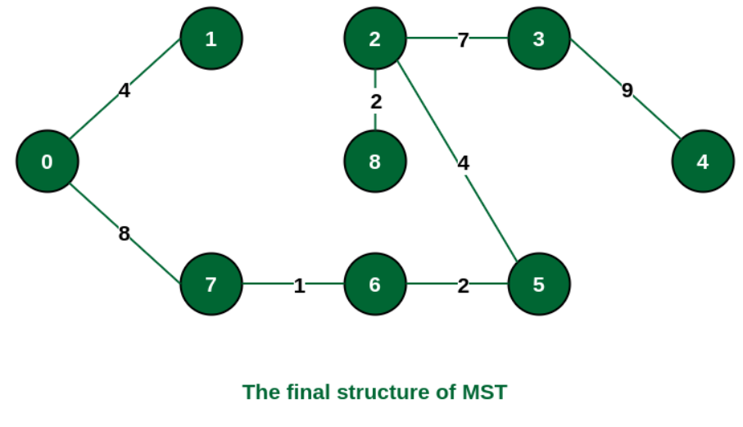
Practice Problem
The final structure of the MST is as follows and the weight of the edges of the MST is (4 + 8 + 1 + 2 + 4 + 2 + 7 + 9) = 37.
Notes:
New Courses replaced with New Programmes

Slide 21
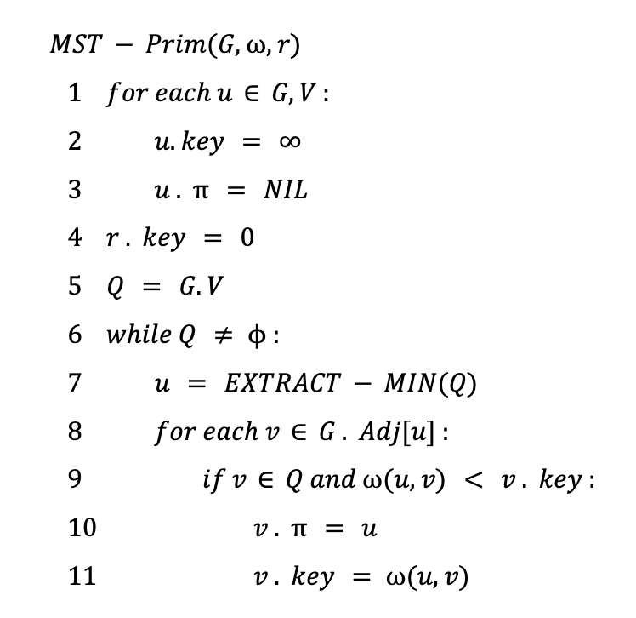
Pseudo code of of Prim’s Algorithm
Notes:
New Courses replaced with New Programmes

Slide 22
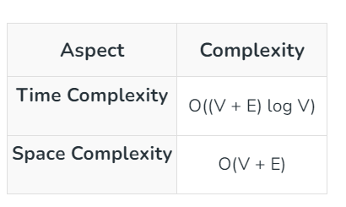
Time and Space Complexity Analysis of Prim’s Algorithm
Notes:
New Courses replaced with New Programmes

Slide 23
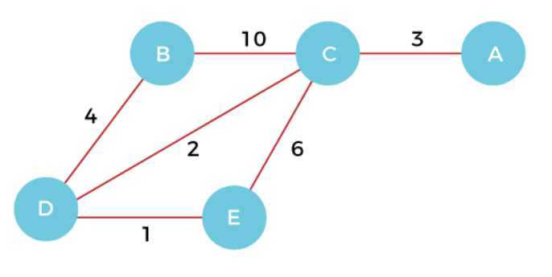
Exercise Problem
Consider the following Graph G and obtain the minimum spanning tree using Prims Approach
Notes:
New Courses replaced with New Programmes

Slide 24
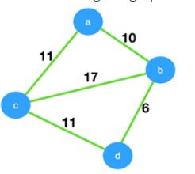
Test Your Knowledge
1. Consider the given graph. What is the weight of the minimum spanning tree using the Prim’s algorithm, starting from vertex a?
a) 23 b) 28 c) 27 d) 11
Answer: (C)
Notes:
New Courses replaced with New Programmes

Slide 25
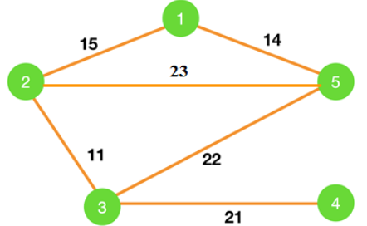
Test Your Knowledge
2. Consider the graph shown below. Which of the following edges form the MST of the given graph using Prim’a algorithm, starting from vertex 4.
a) (4-3)(5-3)(2-3)(1-2) b) (4-3)(3-5)(5-1)(1-2) c) (4-3)(3-5)(5-2)(1-5) d) (4-3)(3-2)(2-1)(1-5)
Answer (D)
Notes:
New Courses replaced with New Programmes

Slide 26
Test Your Knowledge
3. Which of the following is false about Prim’s algorithm? a) It is a greedy algorithm b) It constructs MST by selecting edges in increasing order of their weights c) It never accepts cycles in the MST d) It can be implemented using the Fibonacci heap
Answer (B)
4. Which of the following is true? a) Prim’s algorithm initialises with a vertex b) Prim’s algorithm initialises with a edge c) Prim’s algorithm initialises with a vertex which has smallest edge d) Prim’s algorithm initialises with a forest
Answer: (A)
Notes:
New Courses replaced with New Programmes

Slide 27
Test Your Knowledge
3. Consider the following statements. S1. Kruskal’s algorithm might produce a non-minimal spanning tree. S2. Kruskal’s algorithm can efficiently implemented using the disjoint-set data structure. a) S1 is true but S2 is false b) Both S1 and S2 are false c) Both S1 and S2 are true d) S2 is true but S1 is false
Answer (D)
4. Which of the following is NOT a step in Kruskal's algorithm for finding the minimum spanning tree?
a) Initialize an empty graph as the minimum spanning tree b) Sort all the edges in ascending order of their weights c) Select the edge with the highest weight at each step d) Repeat until all vertices are included in the minimum spanning tree
Answer: (C)
Notes:
New Courses replaced with New Programmes

Slide 28
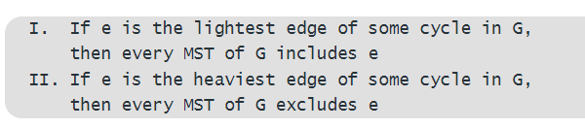
Test Your Knowledge
5. G = (V, E) is an undirected simple graph in which each edge has a distinct weight, and e is a particular edge of G. Which of the following statements about the minimum spanning trees (MSTs) of G is/are TRUE
I only
II only
Both I and II
Neither I or II
Answer (B)
Notes:
New Courses replaced with New Programmes

Slide 29
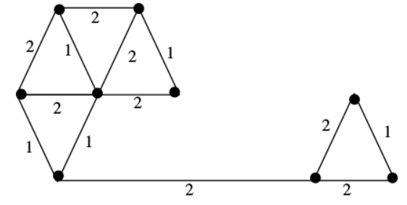
Test Your Knowledge
6. What is the largest integer m such that every simple connected graph with n vertices and n edges contains at least m different spanning trees?
1
2
3
n
Answer (C)
7. The number of distinct minimum spanning trees for the weighted graph below is ____
4
5
6
7
Answer (C)
Notes:
New Courses replaced with New Programmes

Slide 30
REVIEW
Prim's Algorithm is a greedy algorithm that is used to find the minimum spanning tree from a graph.
It finds the subset of edges that includes every vertex of the graph such that the sum of the weights of the edges can be minimized.
Notes:
New Courses replaced with New Programmes

Slide 31

References
https://www.boardinfinity.com/blog/graphs-in-data-structure/.
https://www.geeksforgeeks.org/what-is-graph-data-structure/
https://www.tutorialspoint.com/data_structures_algorithms/graph_data_structure.html.
https://www.simplilearn.com/tutorials/data-structure-tutorial/graphs-in-data-structure
https://www.geeksforgeeks.org/applications-of-graph-data-structure/
https://www.upgrad.com/blog/graphs-in-data-structure/
https://www.youtube.com/watch?v=4IZ80K72OXo
Notes:
New Courses replaced with New Programmes

Slide 32
THANK YOU

